Slide 1
AccessAI ML Pro-Summarizer (AMPS)
Advancing S.T.E.M.
NSBE 2026
Team:
Daniel Anorue
Adeboye Adenuga
Ezra Olagoke
Imole Michael Oyetibo
Gabriel Kiveu
Marius Keita

Slide 2
AMPS Overview
Project Scope
Visual and learning disabilities
Barriers
Technical Specs
Target impacts
Conclusion

Slide 3


AMPS Project Scope
LLM that integrates Claude AI language capabilities with the Web Speech APL.
Design prompts Claude AI to summarize inputted text/content from webpage and output a plain language summary.
Outputted summary from Claude AI is read out loud from built-in web audio feature.

Slide 4
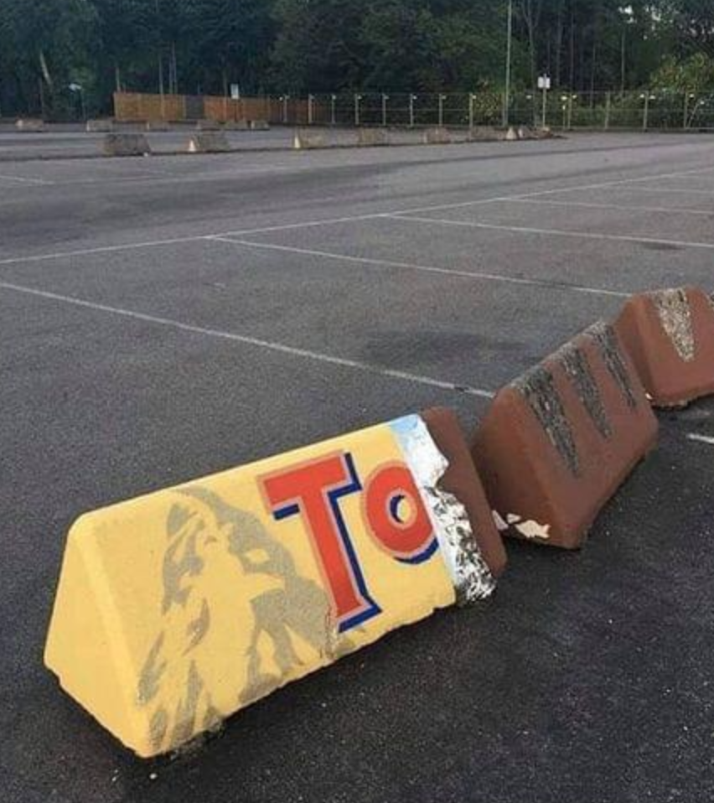
Visual & Learning disabilities
Visual and learning disabilities affect everyday reading in books and online webpages.
Dyslexia.
Reading comprehension deficit.
Disabilities result in barriers.
Affects job and academic performances.

Slide 5
Consequences and barriers
Struggles result in barriers such as phonological processing, understanding content, and sequential organization.
Unable to understand/interpret words or sections which requires re-reading resulting in time consumption.
Difficulty reading long text-heavy articles.
Difficulty maintaining concentration.
Struggles can manifest into low self-esteem, frustration, and anxiety.

Slide 6
AMPS target audience
People with visual and learning disabilities.
Elderly who struggle with processing and absorbing lengthy texts.
Non-native language speakers.

Slide 7
Functional Workflow
User selects webpage text, or uses webpage URL.
AMPS sends text to Claude AI.
Browser built-in speech-engine reads Claude AI summary aloud.
Claude AI converts user-selected text into plain language summary.

Slide 8
Key Parts
Part 1 – Claude API Integration
Part 2 – Text to Speech

Slide 9
Claude API Integration
Model used –
Fast, cheap, easy for a hackathon.
Claude receives command to summarize user-selected text.
claude-haiku-4-5-20251001

Slide 10
Web Speech API (Text to Speech)
Web speech capability is already built within chrome (no install or API required).
Web-available voices are utilized.

Slide 11
Technical Constraints
Pure JavaScript, no frameworks or external libraries.
Chrome Extension Manifest V3.

Slide 12
Target impacts
Removes barriers for those with visual/learning disabilities.
Simplifies content that may be relatively difficult for non-native speakers.
Simplifies sites overloaded with ads and poor structure.

Slide 13
Conclusion
Highly efficient webpage summarizer.
Utilizes built-in and free/available systems including Claude AI and webpage audio.
Removes barriers due to visual and learning disabilities.
Advances current screen reading tools.

